Slide 1
Scrum
Instructor: Jay Mathur
Email: Jitendra@Piit.Us

Slide 2


Slide 3

Scrum Values
Focus
  “Because we focus on only a few things at a time, we work well together and produce excellent work. We deliver valuable items sooner.”
Courage
  “Because we work as a team, we feel supported and have more resources at our disposal. This gives us the courage to undertake greater challenges.”
Openness
  “As we work together, we express how we’re doing, what’s in our way, and our concerns so they can be addressed.”
Commitment
  “Because we have great control over our destiny, we are more committed to success.”
Respect
  “As we work together, sharing successes and failures we come to respect each other and to help each other become worthy of respect.”

Slide 4
Definition of Scrum
Scrum is:
  Lightweight
  Simple to understand
  Difficult to master
Scrum is a process framework that has been used to manage complex product development since the early 1990s
It’s not a process or a technique for building products
Scrum is a framework within which you can use various processes and techniques (CI, TDD, BDD)

Slide 5
Components of Agile Scrum Development
The Scrum Team
Scrum Events (Ceremonies)
Scrum Artifacts
Scrum Rules

Slide 6
The Scrum Team
Scrum Teams are composed of 7 +/- 2 members (only 5-9 members)
No Team Leader to delegate tasks or decide how a problem will be solved
The Scrum Team, as a whole unit, decides how to address issues and solve problems
Each team member is an important part of the team and is expected to carry a product from inception to completion
Note – Scrum Team focuses on the “Product” not the “Project”
  Product is the solution being built
  Project generally refers to the effort to build an application or system

Slide 7
Scrum Team Roles
The Product Owner
  No “Project Manager” role
The ScrumMaster
The Development Team

Slide 8
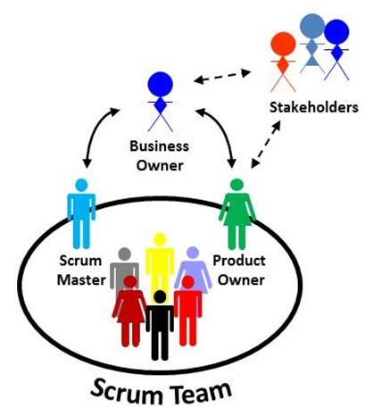

Slide 9
The Product Owner
Project’s Key Stakeholder
Usually an internal or external customer
  Can also be a spokesperson for the customer
Conveys the overall mission and vision for the product which the team is building
Accountable for:
  Managing the Product Backlog
  Accepting completed increments of work by the development team

Slide 10

Product Owner VS Project Manager
Project Manager Responsibilities | Product Owner Responsibilities
Activity Planning and Sequencing | Understand the users’/customers’ needs
Resource Planning | Collaborate with development team
Budgeting | Manage the Stakeholders
Risk Analysis | Create the business model
Team Leadership | Develop the Product Roadmap
Monitoring Progress | Describe the User Experience (UX) and product features
Time/Cost Estimating | Set the sprint goals, detail stories
Controlling Quality | Update the UX/feature description
 | Coordinate the Product Launch

Slide 11
The ScrumMaster
Servant Leader to the Product Owner, Development Team, and Organization
Has no hierarchical authority over the Scrum Team
ScrumMaster ≠ Product Owner/Project Manager/Manager
Facilitator
  Ensures that the Scrum Team adheres to the Scrum Theory, practices, and rules
Protects the team by doing anything possible to help the team perform at the highest level
  Removes Impediments
  Facilitates Meetings
  Helps Product Owner in Backlog Grooming

Slide 12
ScrumMaster Service to Product Owner
ScrumMaster serves the Product Owner
  Finding techniques for effective Product Backlog Management
  Helping the Scrum Team understand the need for clear and concise Product Backlog items
  Understanding Product Planning in an empirical environment
  Ensuring the Product Owner knows how to arrange the Product Backlog to maximize Value
  Understanding and practicing Agile concepts
  Facilitating Scrum Ceremonies

Slide 13
ScrumMaster Service to Development Team
ScrumMaster serves the Development Team
  Coaching the Development Team in the concepts of self-organization and cross-functionality
  Helping the Development Team to create high-value products
  Removing impediments to the Development Team’s progress
  Facilitating Scrum Ceremonies
  Coaching the Development Team in moving towards a more Scrum-like environment if necessary

Slide 14
ScrumMaster Service to the Organization
ScrumMaster serves the Organization
  Leading and coaching the organization in its Scrum adoption
  Planning Scrum implementations within the organization
  Helping employees and stakeholders understand and enact Scrum and empirical product development
  Causing change that increases productivity of the Scrum Team
  Working with other ScrumMasters to increase the effectiveness of the application of Scrum in the organization

Slide 15
The Development Team
Self-Organizing & Cross-Functional Team
Have the skills necessary to deliver shippable increments at the completion of each sprint
Includes more than just “programmers” or “developers”
  Anyone who participates in the creation of the delivered increment is part of this team
There are no titles in the Development Team
NO ONE tells Development Team HOW to convert the Product Backlog into shippable increments
  No one tells them how to program, how to test, etc.

Slide 16
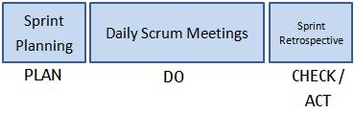
Scrum Ceremonies
The Sprint
Sprint Planning
Daily Stand-up
The Sprint Review
The Retrospective

Slide 17
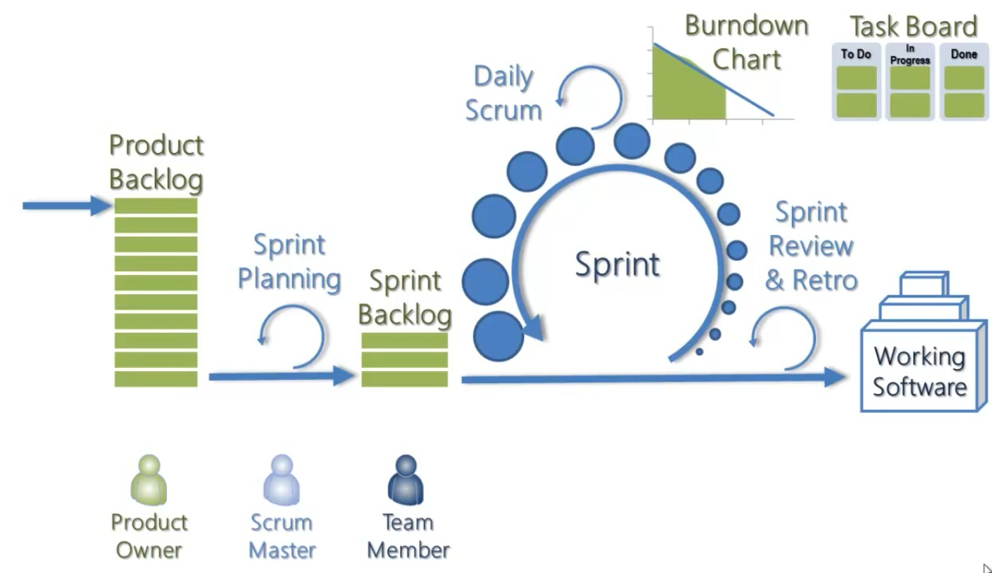

Slide 18
The Sprint
A Time-Boxed period
Specific work is completed & ready for review within this time-boxed period
2-4 weeks long
Can be as short as 1 week
Inspection and adaptation occurs on a daily basis
  Assess progress towards the sprint goal – When?
No changes to requirements are made during a Sprint

Slide 19
The Sprint con’t
Cancelling a Sprint
  Can only be canceled before the time-boxed period is over
  Only the Product Owner has the authority to do so
Would be canceled if the Sprint Goal becomes obsolete
  Company changes direction
  Market/Technology conditions change

Slide 20
Daily Stand-up
Meeting held daily to organize the day
Three questions must be answered by all Scrum Team members:
  What you completed yesterday
  What you will work on today
  What (if any) impediments you face that block your progress
No more than 15-20 minutes long

Slide 21
The Sprint Review
“Show and Tell”
A demonstration event for the Scrum Team to present the work completed during the sprint
Product Owner checks the work against pre-defined acceptance criteria
  Accepts or Rejects the work
Stakeholders/clients provide feedback to ensure that the delivered increment met the business need

Slide 22
The Retrospective
Final Team meeting in the Sprint
Facilitated by the ScrumMaster
Determines:
  What went well
  What didn’t go so well
  How the team can improve in the next Sprint
Opportunity for the team to focus on its overall performance and identify strategies for continuous improvement
ScrumMaster acts as a coach
  Doesn’t tell the team what to do/not do
  Guides the team’s discussion

Slide 23
Scrum Artifacts
Product Backlog
Sprint Backlog
Increment
  PSI

Slide 24
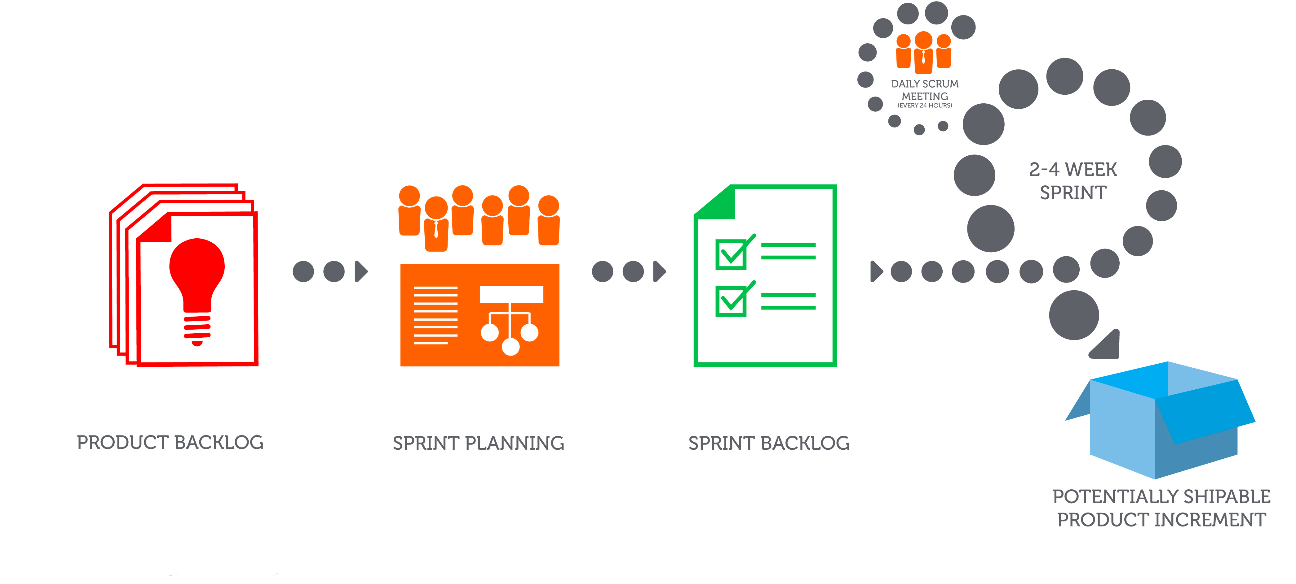

Slide 25
Product Backlog
Owned by the Product Owner
Single most important document that outlines every requirement for a system or product
To-Do List
Consists of Work Items
  User Stories (requirements)
  Tasks
Completion of these tasks produces the deliverable product with business value
Items are ordered in terms of business value

Slide 26
Product Backlog Management
Tasks involved in managing the Product Backlog include:
  Clearly expressing Product Backlog items
  Ordering the items in the Product Backlog to best achieve goals and missions
  Optimizing the value of the work the Development Team performs
  Ensuring that the Product Backlog is visible, transparent, and clear to all, and shows what the Scrum Team will work on next
  Ensuring the Development Team understands items in the Product Backlog to the level (or degree) needed

Slide 27
Sprint Backlog
Specific list of items taken from the Product Backlog
Items on here are what must be completed during that sprint
Scrum Team decides what to take from the Product Backlog during Sprint Planning
Once Sprint Backlog is created, it doesn’t change for the duration of the sprint
  Requirements can change, but only outside of the sprint

Slide 28
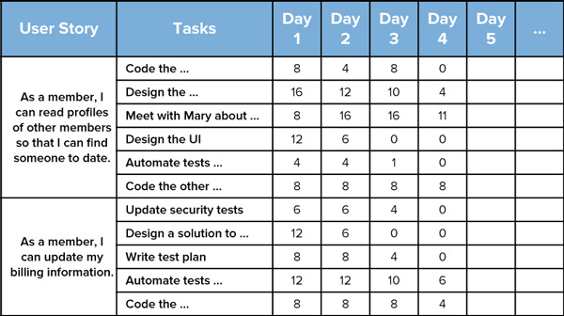

LOE required for each task per day

Slide 29
Increment
Sum of all product backlog items that have been completed since the last software release
Up to the Product Owner to decide when an Increment is released
But…it’s the team’s responsibility to make sure everything that is included in an increment is actually ready to be released
Also referred to as the Potentially Shippable Increment (PSI)
Potential because Product Owner decides if he/she wants to accept or reject

Slide 30
Scrum Rules
Rules of Agile Scrum should be completely up to the team and governed by what works best for their process
The best Agile Coaches will tell teams to start with the basic scrum events mentioned earlier and then inspect and adapt based on the team’s unique needs
Continuous improvement in the way the team functions together as a whole

